Slide 1
Building Office Add-ins
@CameronDwyer | https://camerondwyer.com

Slide 2

Agenda
What is an Office add-in?
Ways we can extend and customise Office products using add-ins
The Office JavaScript API
Quick look at Word Add-ins
Quick look at Excel Add-ins
My top 2 tips for getting started with add-in development
Notes:
We are going to discuss what add-ins are, how they allow you to extend Office applications, what the deployment story looks like and some of my tips for getting started in development of these add-ins

Slide 3
What is an add-in?
Extend Microsoft 365 experiences
Documents
Pages
Conversations
Timeline
Notes:
I’m passionate about add-ins and the potential.
There is a great opportunity to extend users spend their time inside of Office application creating or consuming content (in Outlook, or Word, or Teams)
1. You can create more compelling experience by extending MS apps with custom user experiences, in context where they work.
Value proposition here is minimise context switching, by providing users with the information they need, when and where they need it
Examples – Ability to lookup your CRM system to insert customer addresses when in Word, insert map into Teams conversation when you enter an address.
2. Stand alone app that uses Graph API data

Slide 4
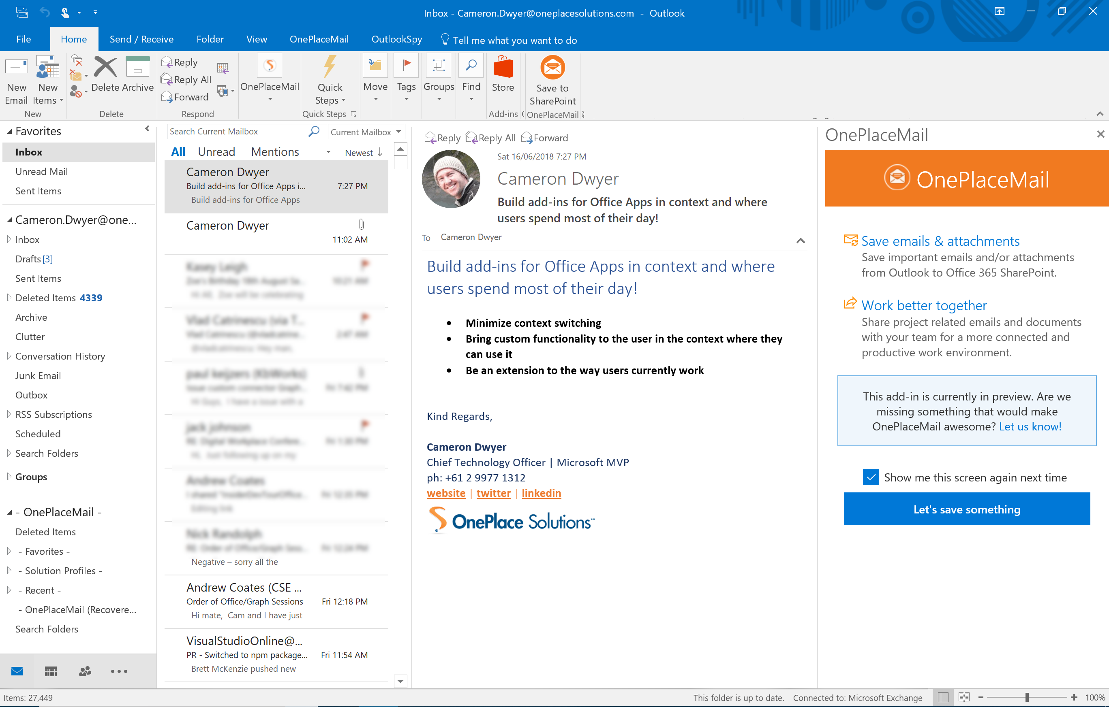
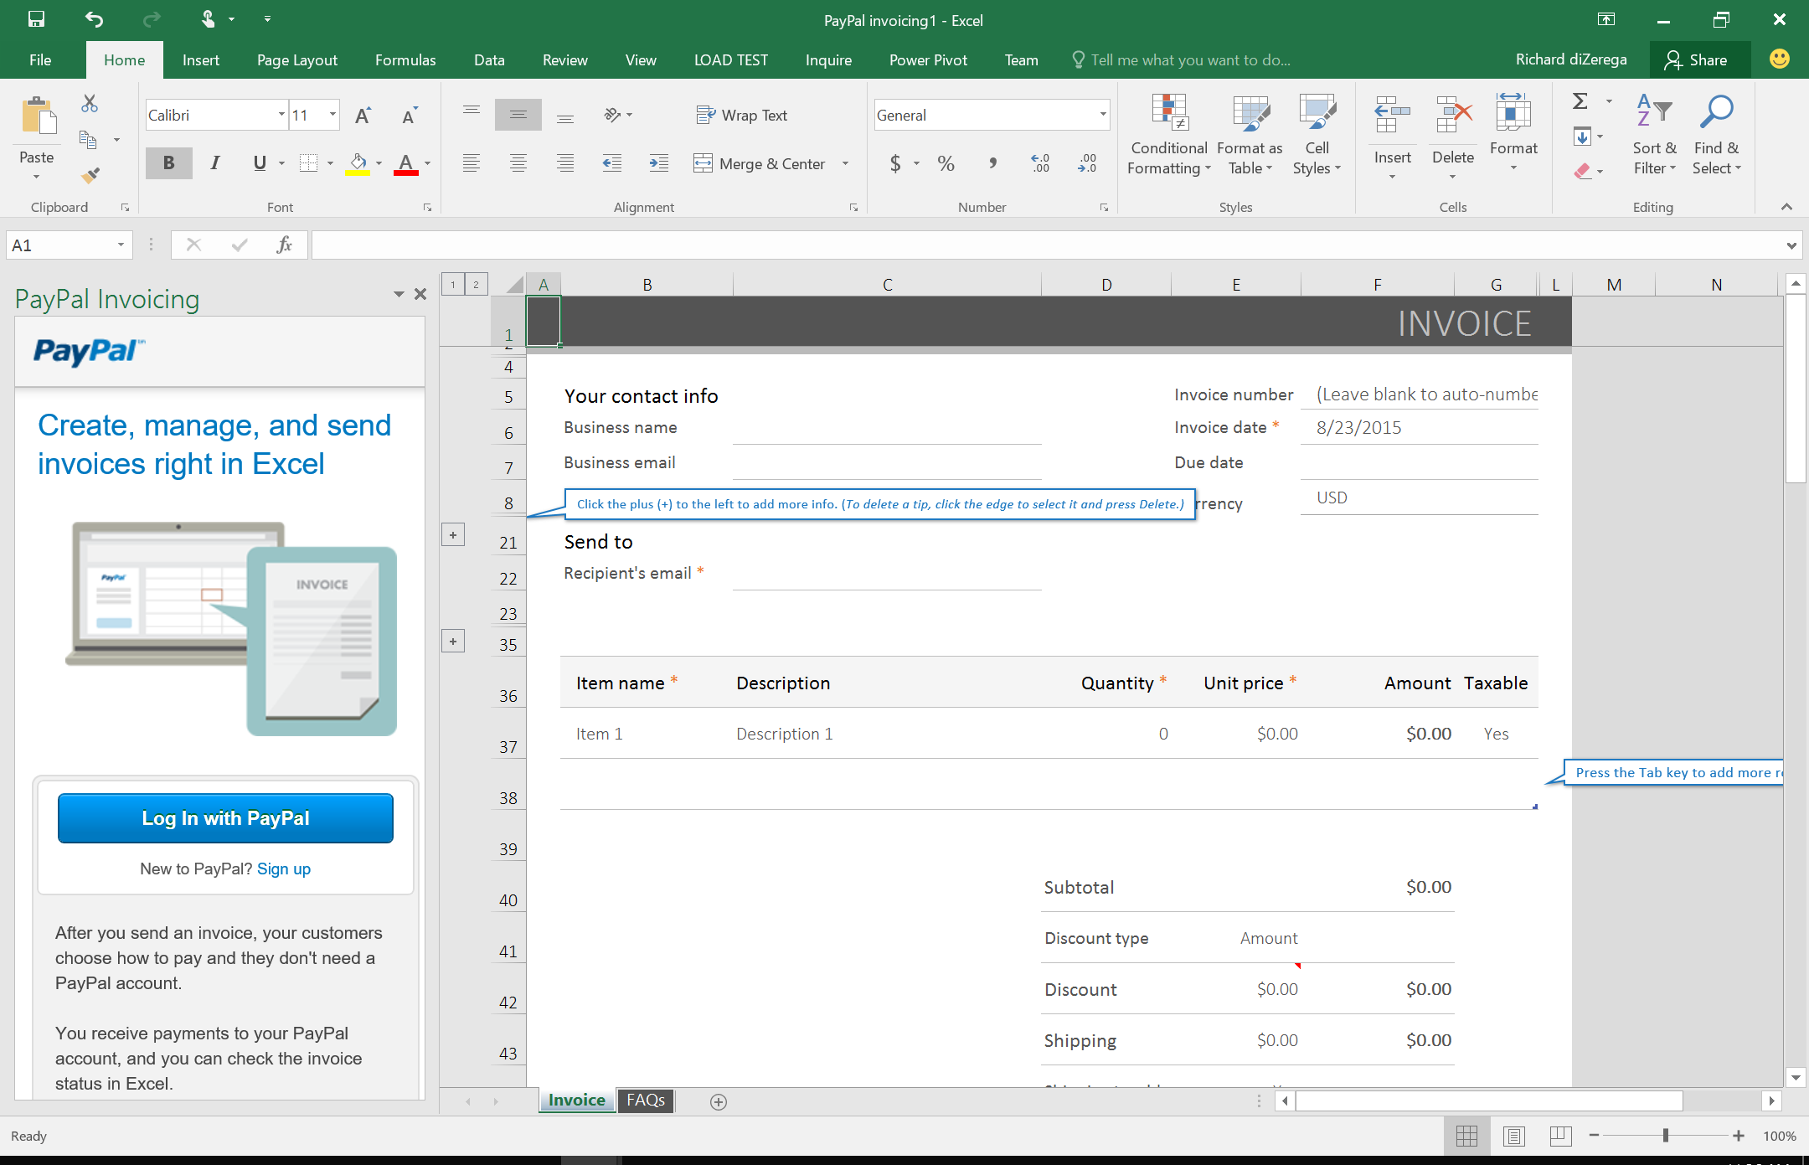
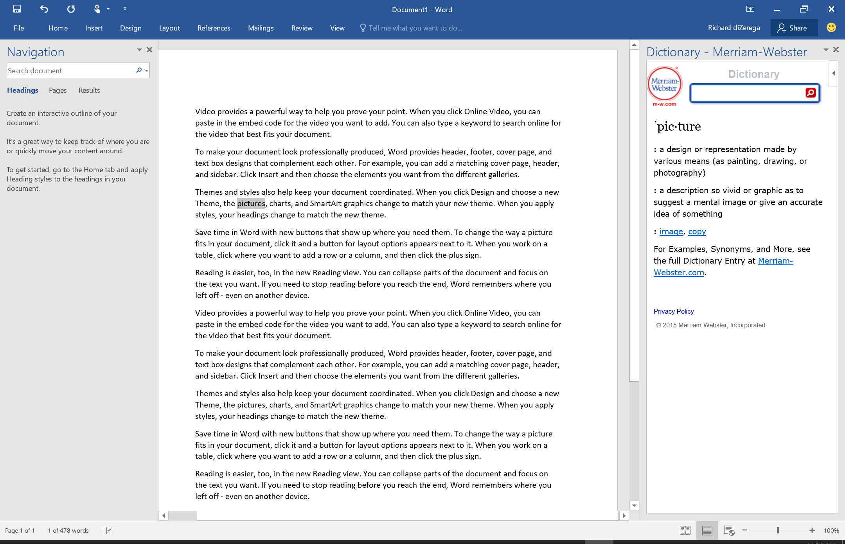
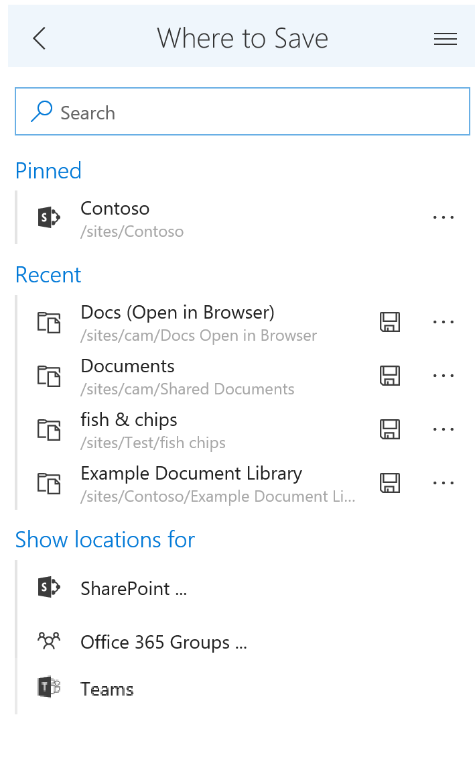
Add-ins in Office
Notes:
** Add example of Team custom tab
When you look at these Office applications there are opportunities to extend using standard web technologies

Slide 5









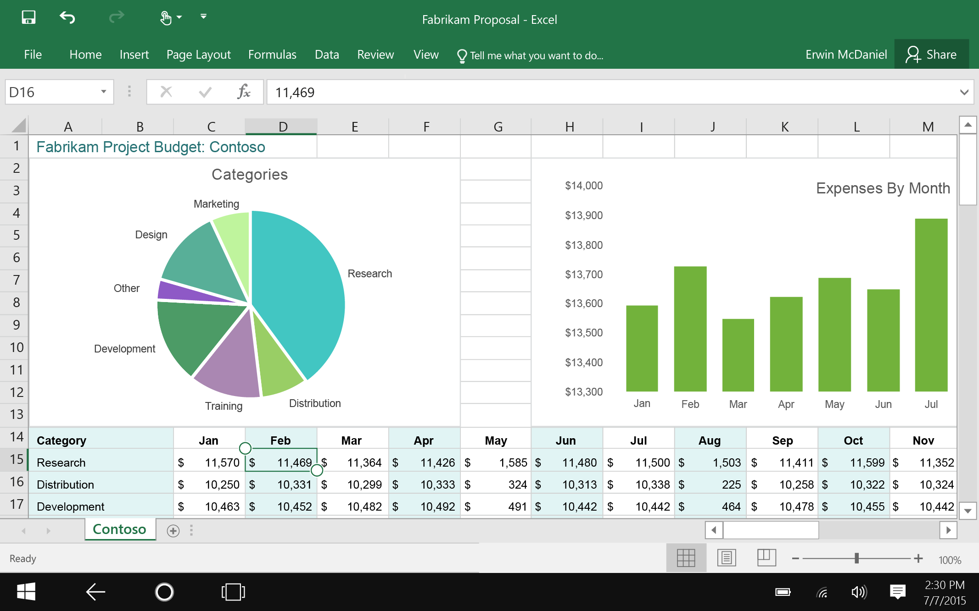
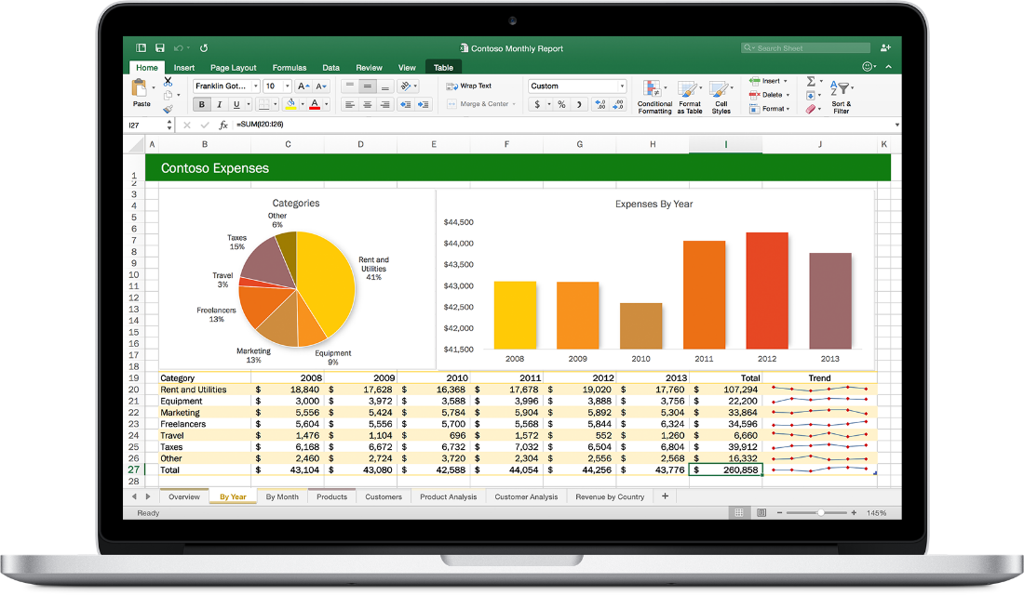


Web technologies
Make your solution part of Office
Cross
platform
Extend Office applications across platforms using web technologies
Modern distribution
Store
Centralized Deployment
Notes:
Office apps now available everywhere across all platforms (Windows, Web, Mac, iPhone, Android)
Makes sense that the development technology to use to extend across all these platforms
Are web technologies – Angular, React, TypeScript, plain old JavaScript
As developer this gives you choice of framework to use
Distribution is no longer installing binary code. It lives with your Office 365 user identity.
Activate once and available (follows) you onto all devices.

Slide 6
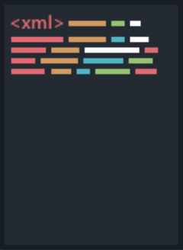


Anatomy of an add-in
XML Manifest
HTML Page
Notes:
2 critical pieces
Manifest = xml to describe the addin (title, description, where/when the add-in will show itself)
e.g. Hello World. Office App can startup and show add-in buttons without executing any add-in code
HTML Page = Manifest points to this and this is what gets loaded into the “frame” in the Office app

Slide 7



Add-in canvases
Task Pane
Add-in that runs beside a document/mail with read/write access
Word, Excel, PowerPoint, Outlook, OneNote, Project
Content
Add-in that runs within a documents content with read/write access
Excel, PowerPoint
Commands
Command in the Office UI to launch add-in or perform UI-less operation
Outlook, Word, Excel, PowerPoint, OneNote

Slide 8
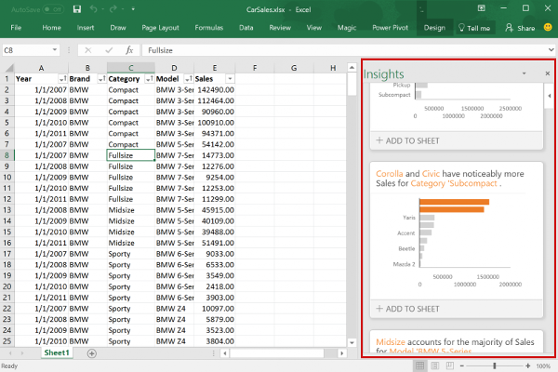
Task Pane

Slide 9
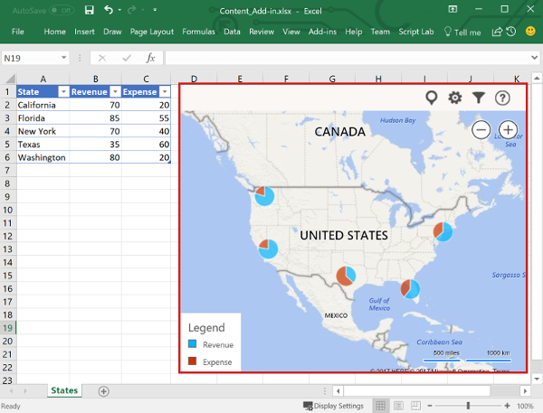
Content Add-in

Slide 10
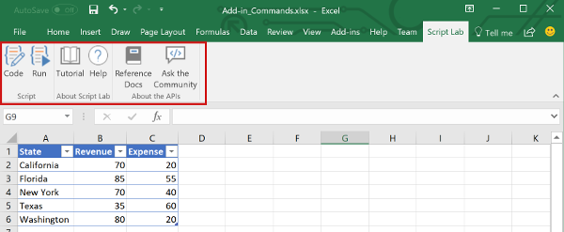
Add-in Commands

Slide 11
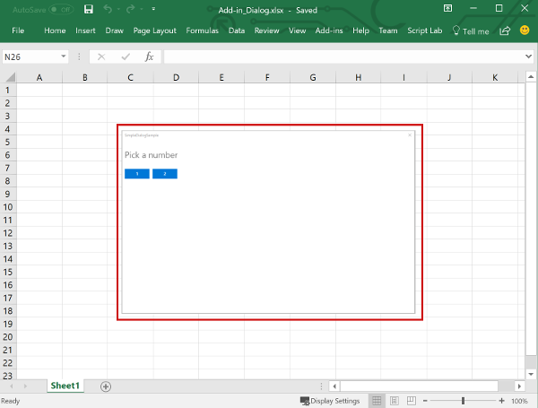
Dialog Box

Slide 12
Office.js – The JavaScript API for Office
Office.js is the new Office API
This is a JavaScript library that you can include in the web page of your add-in
Provides access to the object models of host Office application (including current document or item)
Office.js dynamically loads in Common APIs (apply to all Office applications) and host specific APIs (such as the Word API or Excel API)
This allows your add-in to interact with the Office app
Microsoft iterating quickly on these APIs to remove barriers in converting VSTO add-ins

Slide 13
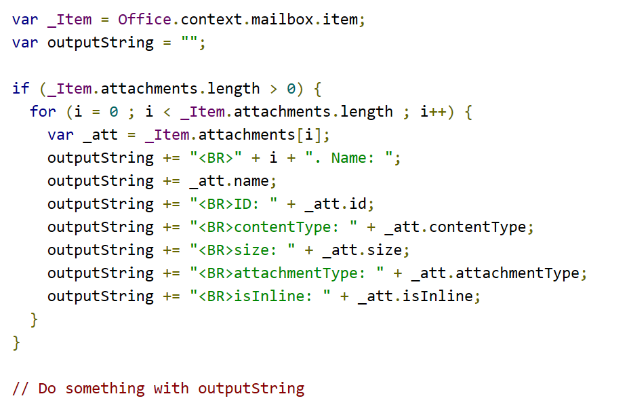
Example Office.js code
Accessing a mail item in an Outlook add-in

Slide 14
Word Add-ins

Slide 15
Anatomy of Office.js Add-in for Microsoft Word
Initialize Office when Add-in page first loads via Office.initialize
Office.initialize = function (reason) {
if (!Office.context.requirements.isSetSupported('WordApi', 1.3)) {
console.log(‘Unsupported client’);
}
else {
Word.run(function (context) {
// Do Word stuff
context.load(obj, options);
return context.sync()
.then(() => {
// Do more Word stuff
});
})
.catch(function (error) {
console.log("Error: " + JSON.stringify(error));
});
}
Check if client supports API version
Get context to perform operations
Load desired properties
Sync context to execute batch operations
Use promises to get results or perform additional operations
Handle errors
Notes:
All Office add-ins must call Office.initialize when a page first loads in the add-in
If using newer Office.js capabilities, it is important to check if the client supports those extensions. You can check this using the requirements.isSetSupported operation.
For Word JavaScript APIs, you should get context using the Word.run operation.
Using the context, you can load any properties you might need to work with.
Calling context.sync will execute a batch of operations.
Context.sync returns a promise that can be used to get results or a previous operation and/or perform new operations.
It is a best practice to catch and handle errors that might occur when working with the Word APIs

Slide 16
Text and Paragraphs
Hierarchy of a document
Office.js provides context to a Word document through Word.run and the context.document property.
The document contains a body, which contains a number of collections, including paragraphs, tables, and more.
The relationships in this hierarchy are exposed as properties in the API allowing traversal up (ex: paragraph.parentBody), down (ex: body.paragraphs), and horizontal (ex: paragraph.getNext() or paragraph.getPrevious()).
Paragraphs
Office.js allows you to insert new paragraphs and edit/delete/clear existing paragraphs and how they appear in a document.
Paragraphs are aware of their siblings using getNext and getPrevious operations as well as when inserting a paragraph relative to self (using “before” of “after” location).
document
body
paragraph
paragraph
paragraph
Notes:
Before manipulating a Word document, it is important to understand it’s hierarchy and how that relates to the objects you will work with in Office.js.
As seen in the previous slide, Office.js provides context to an add-in via Word.run…that context contains a docment property.
A document has a body, which contains a number of paragraphs.
Office.js allows you to easily traverse and manipulate this hierarchy.
Paragraphs are aware of their siblings, with abilities to getNext and getPrevious
You can also insert paragraphs relative to one another

Slide 17
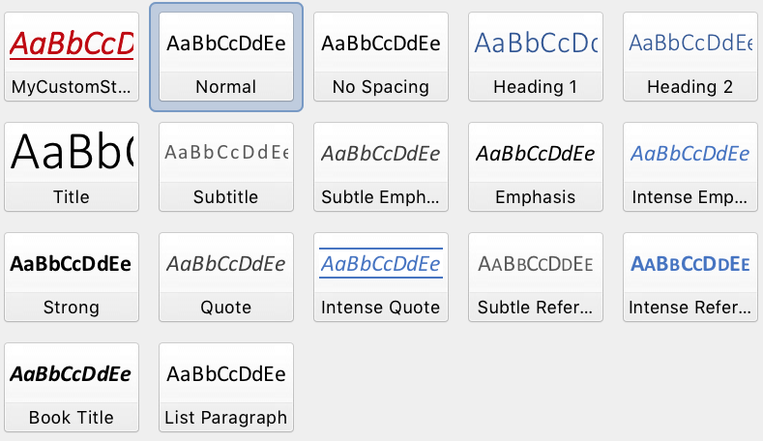
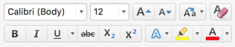
Styles and Formatting
Styles
Styles in Microsoft Word are similar to a CSS class in HTML. They provide a pre-configured and reusable set of formatting to be applied to a paragraph or range of text.
Office.js can apply both out of the box styles and custom styles to paragraphs and ranges of text.
Fonts
Modifying a font is similar to applying an inline style in HTML.
Setting a font allows you to manipulate the font family, weight, size, colors, and more.
Like styles, fonts can be applied to an entire paragraph or range of text.
Paragraph formatting
In addition to styles and fonts, paragraphs offer additional formatting through Office.js such as alignment, indention, and line spacing.
Notes:
Styles and Formatting are what make an attractive document and Office.js allows you to easily work with styles and formatting.
Styles are similar to a CSS class in HTML as they provide pre-configured and reusable formatting for paragraphs and text ranges
Office.js can apply both out of the box and custom styles
Fonts are similar to inline styles in HTML…explicitly setting a font only applies to that paragraph or range.
You can manipulate the font family, weight, size, colors, and more
Office.js also allows you to apply formatting to paragraphs such as alignment, indention, and line spacing.

Slide 18
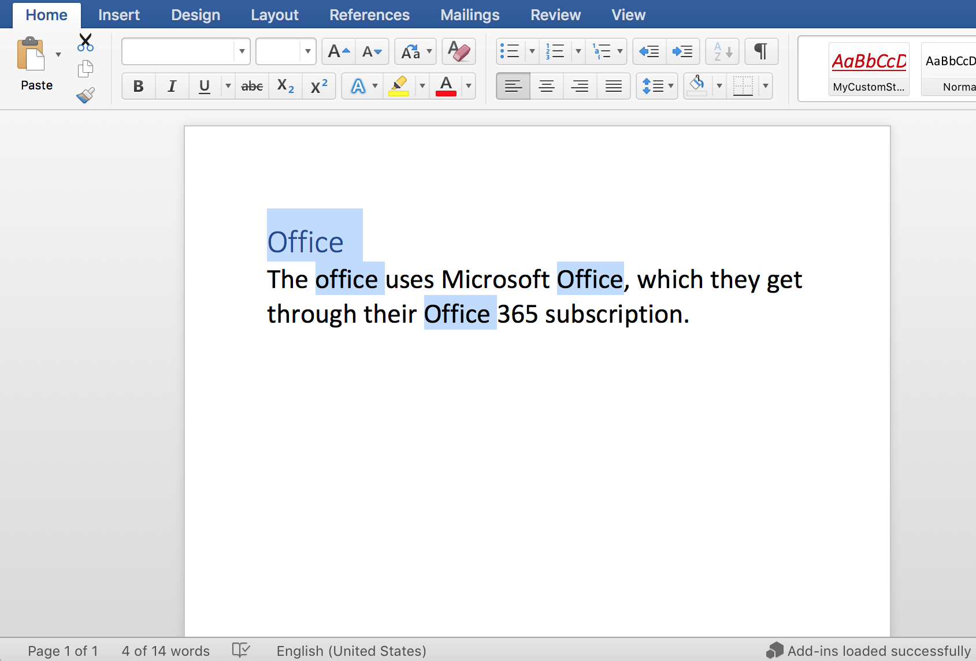
Selections and Ranges
Ranges
A range is any contiguous area of a document in Microsoft Word.
Ranges can be established through a number of ways, including search, selection, or conversion (ex: paragraph.getRange()).
Selections
Selections allow you to manipulate both the content and location of focus in the document.
You can get the selection as a range or set the selection on a range
Notes:
When working with Office add-ins, you will often here the term range.
A range in Microsoft Word is any contiguous area of a document.
Ranges can be established in a number of ways, including search, selection, and conversion from another Office.js object such as a paragraph
Selections allow you to manipulate both the content and location of focus in a document.
You can get the selection of a range or set the selection on a range

Slide 19
Selections and Ranges
// Get selected range of text
const originalRange = document.getSelection();
// Append text to a range of text (“replace”, “start”, “end”, “before”, “after”)
originalRange.insertText(' added to the end', 'End');
// Select a range of text (selectionMode support “Select”, “Start”, “End”)
someRange.select('Select');
Notes:
The first sample here is getting the selection of the document using document.getSelection()
The next sample is inserting some text at the end of a range…insertText supports a number of location options
Next, we are selecting on a range of text…this will select that text in the document
Finally, the last sample searches a paragraph for some text and replaces each instance of that text

Slide 20
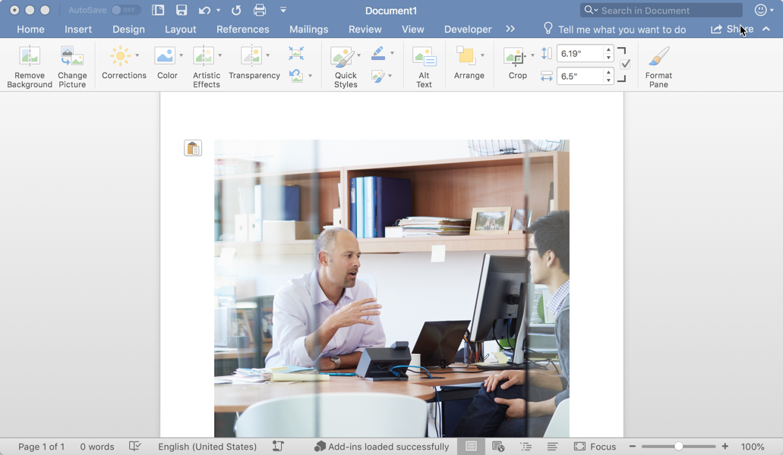
Images
Images
Images can be challenging to work with in JavaScript, but Office.js allows images to be manipulated as base64 encoded strings.
Images can be inserted into the body, paragraphs, or ranges of a document. All of these objects have an inlinePictures collection.
Office.js allows you to manipulate how the images is displayed in the document through properties such as lockAspectRatio, height, width, and more.
Notes:
Images can be difficult to work with in JavaScript, especially in a binary form. Office.js makes it easy to work with images in a Word document by exposing them in their base64 encoded string representation
Images can be inserted in the body, paragraph, or ranges of a document.
Each of these objects contains a inlineImages collection
Office.js can be used to manipulate how images are displayed in a document, including the height, width and aspect ratios.

Slide 21
Images
// Get all inline pictures in body (also valid for paragraph or range)
const images = body.inlinePictures;
// Insert an image from base64 encoded string (insertLocation support “Start”, “End”)
context.document.body.insertInlinePictureFromBase64(base64Image, "End");
// Retrieves the base64 encoded string of an inline picture
var base64 = someInlinePicture.getBase64ImageSrc();
// Locks the aspect ratio and sets the width of an inline picture
someInlinePicture.lockAspectRatio = true;
someInlinePicture.width = 400;
Notes:
The first sample is getting all the inlinePictures in the body of the document
The second sample is inserting an image at the end of the body using a base64 string representation of the image
Next, you see how to read the base64 representation of an image using the getBase64ImageSrc function
Finally, we see how to lock the aspect ratio of an image and modify it’s width

Slide 22
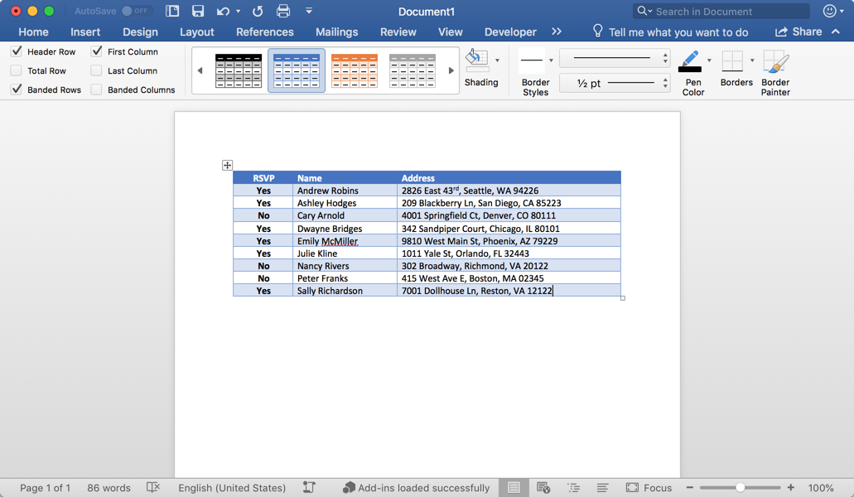
Tables
Tables
Office.js allows a table to be inserted relative to paragraphs, ranges and the body of a document.
The insertTable function specifies the dimensions of the table, the insert location, and a 2D array of values.
The tables property allows tables to be accessed and manipulated in JavaScript on body and range objects.
It is important to note that tables can be inserted relative to a paragraph, but a table does not exist within a paragraph (this is different from an inlinePicture).
Notes:
Office.js allows tables to be inserted relative to paragraphs, ranges, and the body of a document.
The insertTable function accepts the table dimensions, the insert location, and a 2D array of data to display in the table
Only the document body and ranges expose a table collection property as tables do not exist within a paragraph, only relative to a paragraph.

Slide 23
Tables
// Get all tables in body (also valid for range)
const originalRange = body.tables;
// Inserts a 3x3 table into the paragraph
const tableData = [
["Name", "ID", "Birth City"],
["Bob", "434", "Chicago"],
["Sue", "719", "Havana"],
];
paragraph.insertTable(3, 3, "After", tableData);
// Get the number of rows in a table
var rows = table.rowCount;
// Gets the values from a table as a 2D array
var array2D = table.values;
Notes:
The first sample retrieves all the tables in the body of a document.
The second sample is inserting a 3x3 table with data after a paragraph
The final two samples show you how to retrieve specific properties of a table such as the rowCount and actual table data as a 2D array.

Slide 24
Excel Add-ins

Slide 25
Excel object hierarchy
Hierarchy of a workbook
Office.js provides context to an Excel workbook through Excel.run and the context.workbook property.
The workbook contains worksheets, which contains a number of collections, including charts, tables, pivotTables, and more.
Many objects within a worksheet can be accessed directly from the workbook object, including tables and pivotTables.
Worksheets
Worksheets are aware of their siblings using getNext and getPrevious operations.
You can get the active worksheet using workbook.worksheets.getActiveWorkshee() and set the active worksheet using worksheet.activate().
Office.js also offers a number of worksheet events such as onActivated, onDeactivated, onSelectionChanged and more.
workbook
worksheet
table
chart
worksheet
table
chart
Notes:
Before manipulating a Excel workbook, it is important to understand it’s hierarchy and how that relates to the objects you will work with in Office.js.
As seen in the previous slide, Office.js provides context to an add-in via Excel.run…that context contains a workbook property.
A workbook contains worksheets, which contains a number of collections, including charts, tables, pivotTables, and more.
Office.js allows you to easily traverse and manipulate this hierarchy.
Many objects within a worksheet can be accessed directly from the workbook object, including tables and pivotTables.
Worksheets are aware of their siblings, with abilities to getNext and getPrevious
You can get the active worksheet using workbook.worksheets.getActiveWorkshee() and set the active worksheet using worksheet.activate().
Office.js also offers a number of events that developers can hook into for various worksheet actions by a user including onActivated, onDeactivated, onSelectionChanged and more.

Slide 26
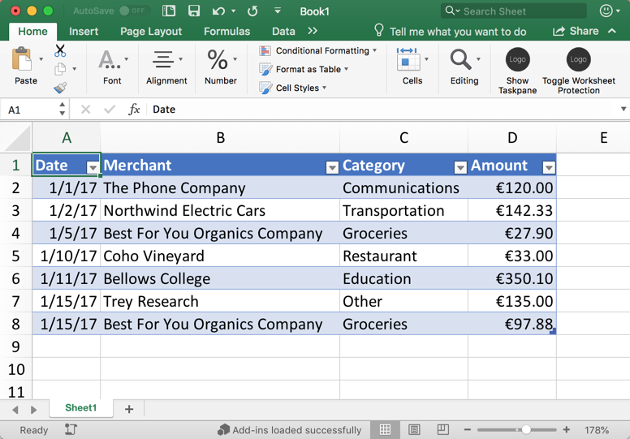
Tables and headers
Ranges
A range represents a set of one or more contiguous cells such as a cell, a row, a column, block of cells, etc.
You can get a range object with Office.js using a worksheet and address (ex: “A1:D4” represents a range from topLeft to bottomRight cells)
Tables
A table is established based on a range of data.
The tables.add function accepts a data range with a flag to indicate if the table has headers or not.
Existing tables can be retrieved by name/id or iterated through.
After the table is added, headers and table rows can be added using 2D arrays.
Headers
A table created with a header flag will use the first row in the data range for its headers.
You can also set header values using the getHeaderRowRange().values property with a 2D array.
Notes:
Ranges
A range represents a set of one or more contiguous cells such as a cell, a row, a column, block of cells, etc.
You can get a range object with Office.js using a worksheet and address (ex: “A1:D4” represents a range from topLeft to bottomRight cells)
Tables
A table is established based on a range of data.
The tables.add function accepts a data range with a flag to indicate of the table has headers or not.
Existing tables can be retrieved by name/id or iterated through.
After the table is added, headers and table rows can be added using 2D arrays.
Headers
A table created with a header flag will use the first row in the data range for its headers.
You can also set headers using the getHeaderRowRange().values property with a 2D array.

Slide 27
Tables and headers
// Get range from worksheet
const range = currWorksheet.getRange('A1:D1');
// Insert table into current worksheet
const table = currWorksheet.tables.add(range, true);
table.name = "ExpensesTable";
// Get table by name (can also be performed on worksheet)
const table = workbook.tables.getItem("ExpensesTable");
// Add header row to table
table.getHeaderRowRange().values = [["Date", "Merchant", "Category", "Amount"]];
// Freeze header row where 1 is the count of rows at top to freeze (0 to unfreeze)
currWorksheet.freezePanes.freezeRows(1);
Notes:
Here are some examples of working with ranges, worksheets, and tables
First, we are getting a range based on address in the current worksheet, again, the current worksheet is available through context.workbook.worksheets.getActiveWorksheet()
Next, we are adding a table to the current worksheet based on the range and naming it the ”ExpensesTable”
We can use this name to easily re-reference the table later as seen in the next code sample
Next, we are setting the header row for the table using a 2D array.
You can also freeze the header row using the freezePanes collection on the worksheet and call freezeRow()

Slide 28
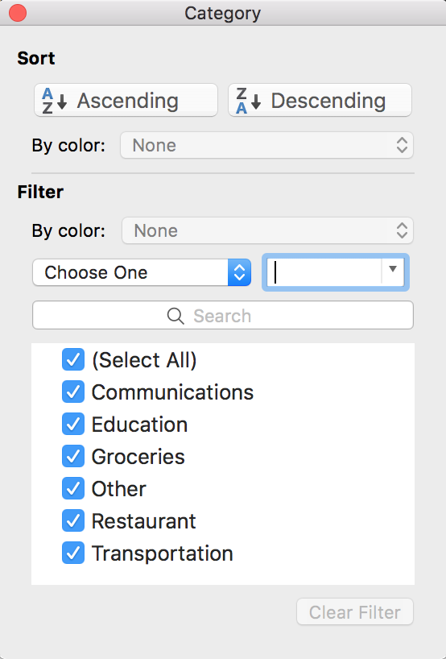
Filtering and sorting tables
Filtering
Any column of a table can be filtered using Office.js.
Filter a column by getting the column and using the applyValuesFilter function on its filter property.
You can also programmatically re-apply filters and clear filters on a table using the table functions reapplyFilters and clearFilters respectively.
Sorting
Table sorting can be applied by passing an array of SortFields to the table.sort.apply() function.
You can re-apply and clear table sorts using table.sort.reapply() and table.sort.clear() respectively.
Notes:
Filtering
Any column of a table can be filtered using Office.js.
Filter a column by getting the column and using the applyValuesFilter function on its filter property
You can also programmatically re-apply filters and and clear filters on a table using the table functions reapplyFilters and clearFilters respectively
Sorting
Table sorting can be applied by passing an array of SortFields to the table.sort.apply() function.
You can re-apply and clear table sorts using table.sort.reapply() and table.sort.clear() respectively.

Slide 29
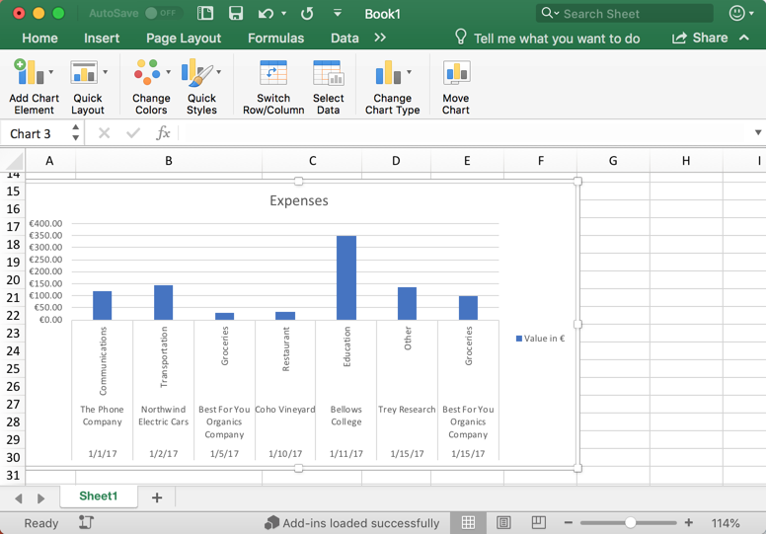
Charts
Charts
Microsoft Excel has become a playground for data manipulation and visualization. So it no surprise that the Excel JavaScript APIs allow developers to add and manipulate charts.
Charts exist within worksheets, but can also be accessed directly from the workbook object.
Charts have a number of complex relational properties that can be used to fine-tune the look of a chart. These include titles, legends, axes, series, labels, format, and much more.
Charts are created based on a data range and are often created in conjunction with tables.
The worksheet.charts.add function is used to create a chart, which accepts a chart type (discussed more in the next slide), a data range, and seriesBy (possible values include Auto, Scalar, Matrix).
Notes:
Charts
Microsoft Excel has become a playground for data manipulation and visualization. So it no surprise that the Excel JavaScript APIs allow developers to add and manipulate charts.
Charts exist within worksheets, but can also be accessed directly from the workbook object.
Charts have a number of complex relational properties that can be used to fine-tune the look of a chart. These include titles, legends, axes, series, labels, format, and much more.
Charts are created based on a data range and are often created in conjunction with tables.
The worksheet.charts.add function is used to create a chart, which accepts a chart type (discussed more in the next slide), a data range, and seriesBy (possible values include Auto, Scalar, Matrix).

Slide 30
Charts
// Insert a clustered column chart using table data
const dataRange = table.getDataBodyRange();
let chart = currWorksheet.charts.add("ColumnClustered", dataRange, "auto");
// Get existing chart by name
let chart = workbook.charts.getItem("MyChart");
// Modify chart properties such as position, titles, colors, sizes, and more
chart.setPosition("A15", "F30");
chart.title.text = "Expenses";
chart.legend.position = "right"
chart.legend.format.fill.setSolidColor("white");
chart.dataLabels.format.font.size = 15;
chart.dataLabels.format.font.color = "black";
chart.series.getItemAt(0).name = "Value in €";
Notes:
This sample shows how to insert a new chart and getting an existing chart based on a name.
The new chart is being defined as a clustered column chart, based on some table data, and asked Excel to figure out if it should be charted rowwise or columnwise
Below you can see how you can use Office.js to manipulate details to perfect a chart

Slide 31
My top 2 tips

Slide 32
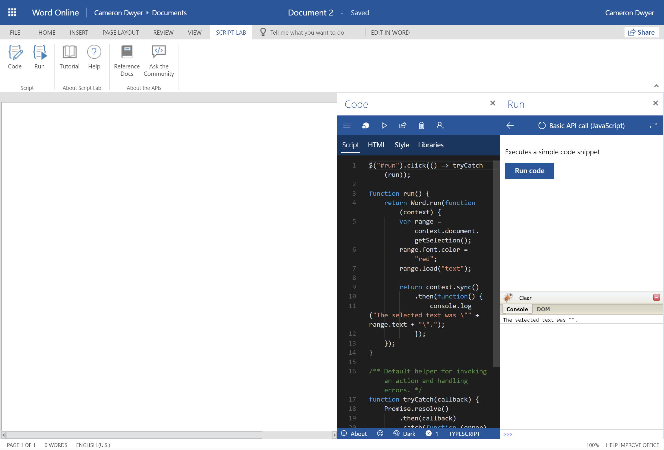
Tip#1 The Script Lab Add-in
Notes:
For exploring the Office.js functionality in real time without needing to code up your own add-in.

Slide 33
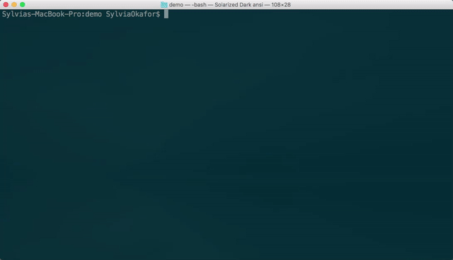
Tip#2 Use the Yeoman generator for Office

Slide 34
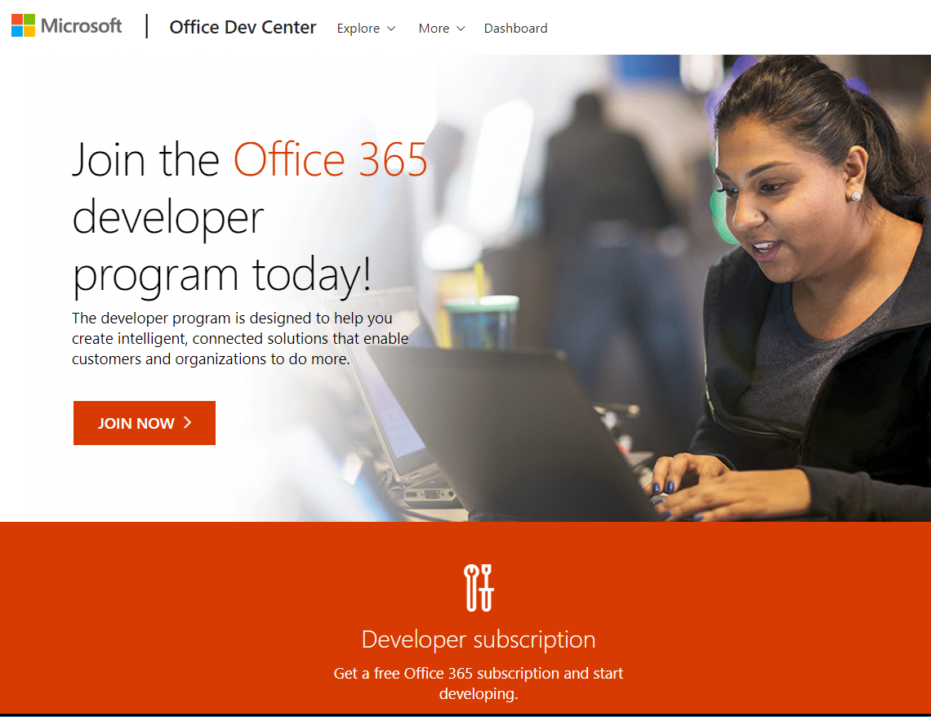
Start your journey here
https://developer.microsoft.com
Join the Office 365 developer program
Get an Office 365 developer tenant (free for 12 months)
Online training
API documentation
Over 500 code sample projects

